Slide 1
Manav Ukani - Pandit DeenDayal Energy University - 2024
Ahmed Mulla - Pandit DeenDayal Energy University - 2024
By Team Tensored

Slide 2
FINAL PRESENTATION
ASSET BUBBLE

Slide 3
Approaches
Analytical Approach
Approaches
Statistical Approach
ML Driven Approach

Slide 4
Analytical
Approach

Slide 5
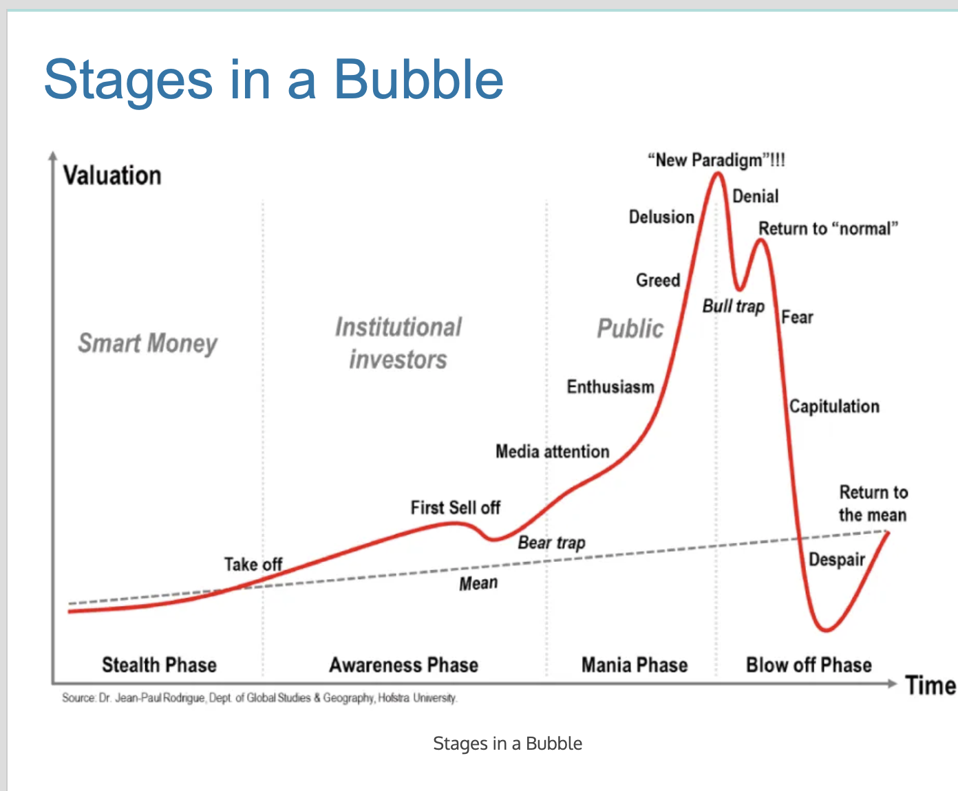

Slide 6
Primal Factors for Asset Bubble

Slide 7
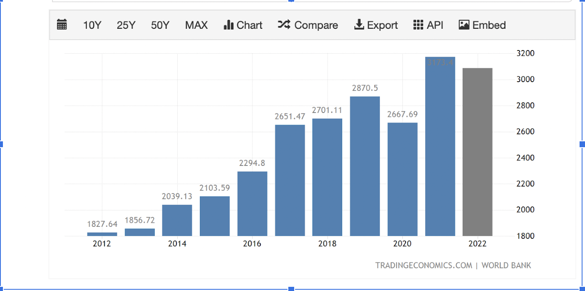
Gross Domestic Product

Slide 8
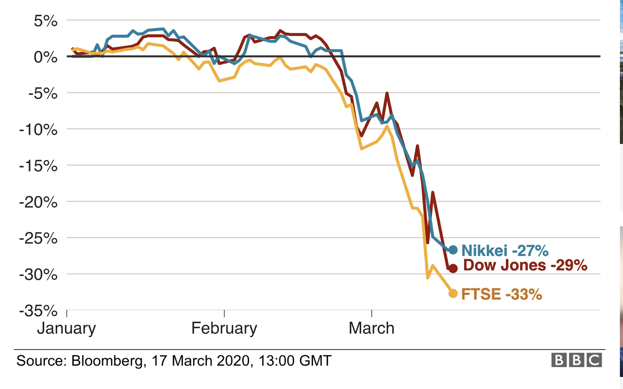

Slide 9
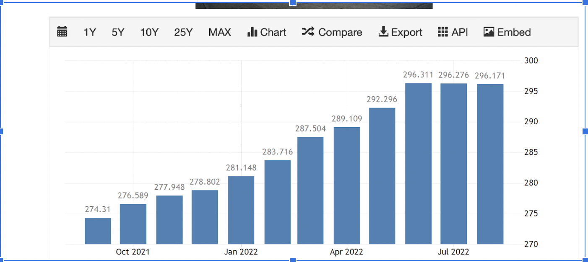
Consumer Price Index

Slide 10
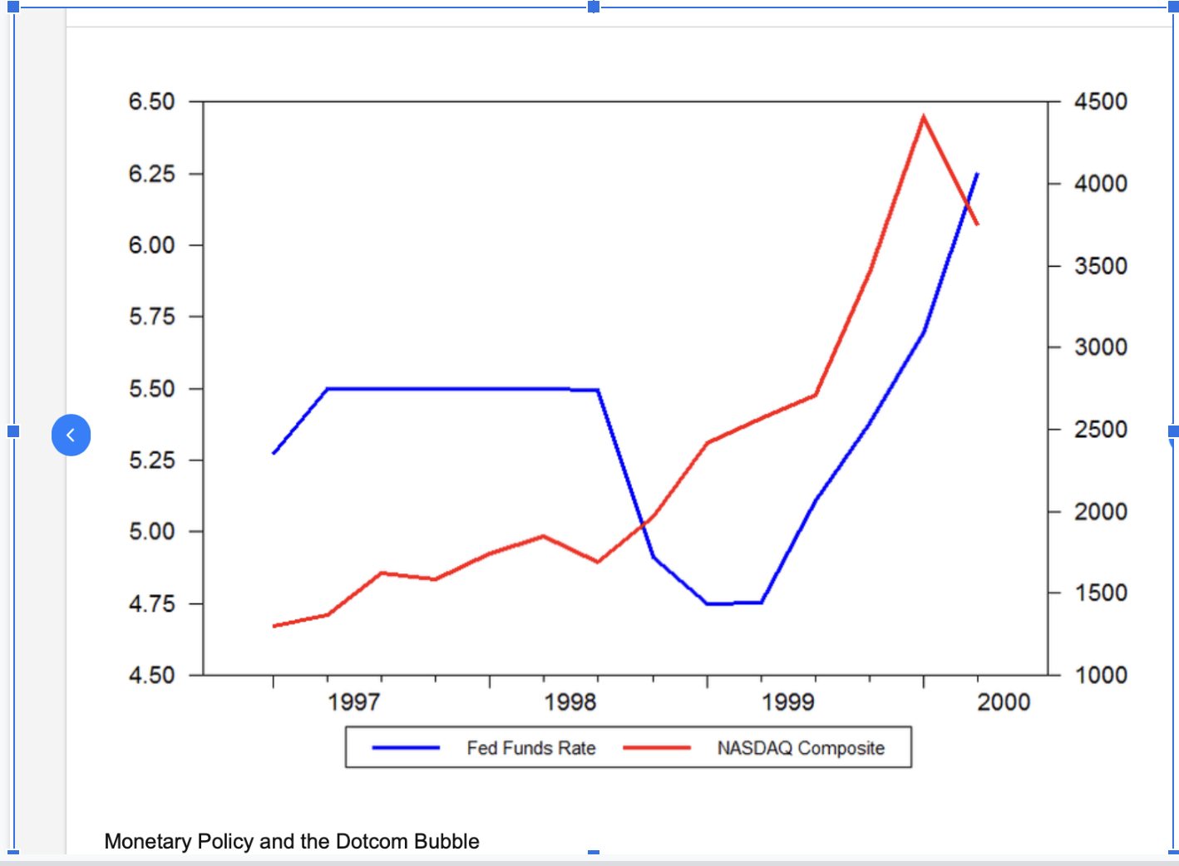

Slide 11
ISM Manufacturing Index
Inflation affects the stock market crash or the overall stocks as consumer spending drops. Value stocks might do well because of their prices haven’t kept with their peers. However growth stocks tend to be shunned by the investors.
Industrial production has been hit due to the coronavirus pandemic since March 2020, when it had contracted 18.7 per cent. It shrank 57.3 per cent in April 2020 due to a decline in economic activities in the wake of the lockdown imposed to curb the spread of coronavirus infections. TAGS: Index of industrial production.

Slide 12
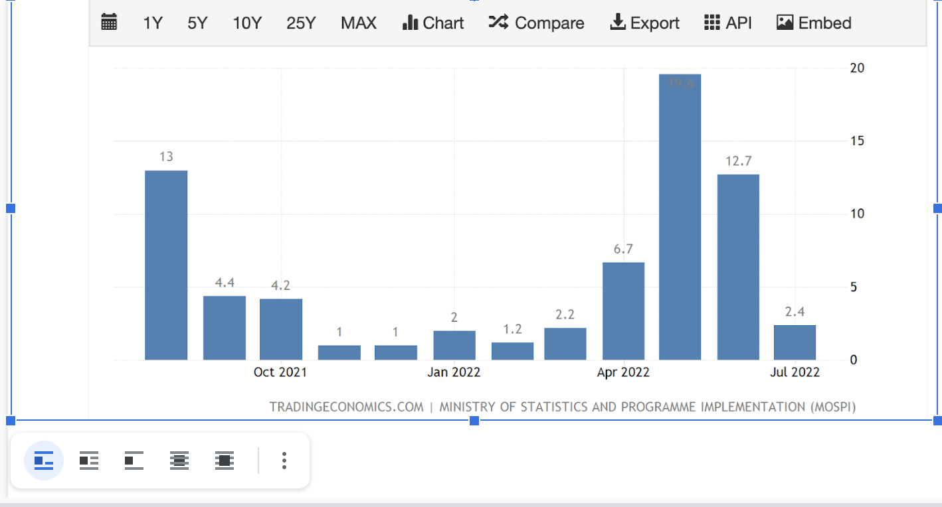
Industrial Production

Slide 13
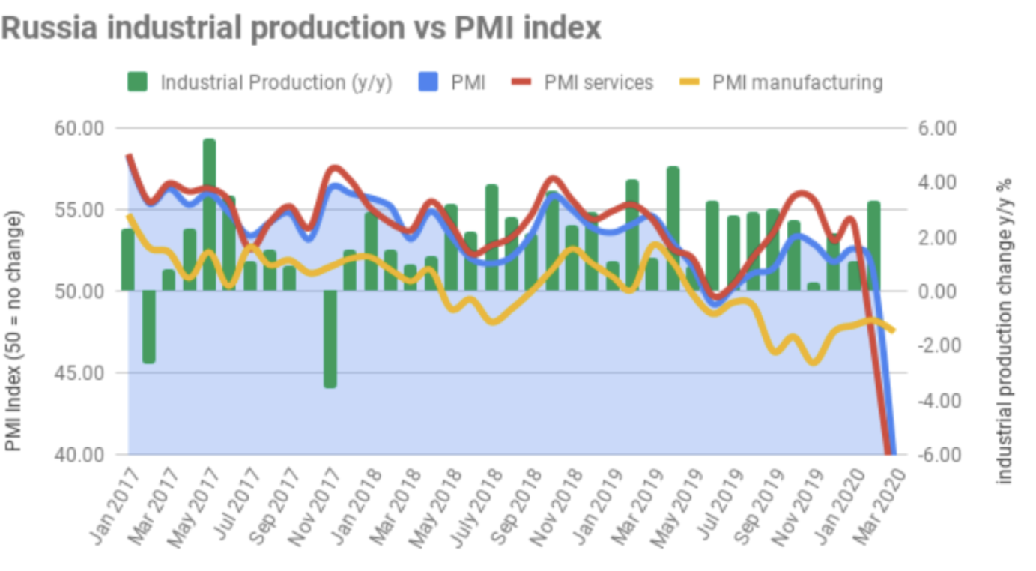

Slide 14
Recession Tracker :
Analyzing Markets Data

Slide 15
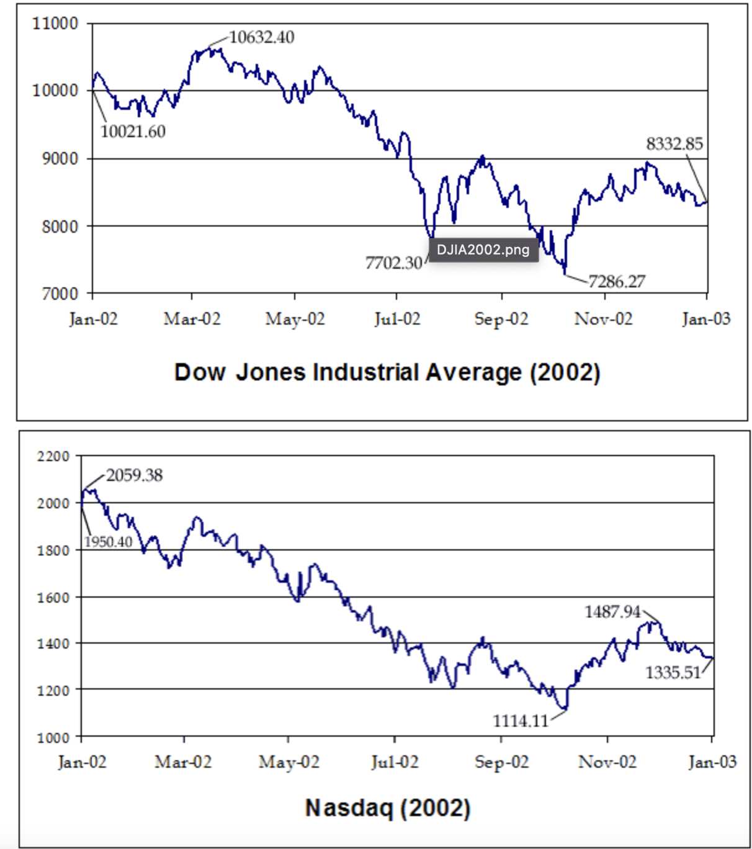
Stock Market (S&P 500)

Slide 17
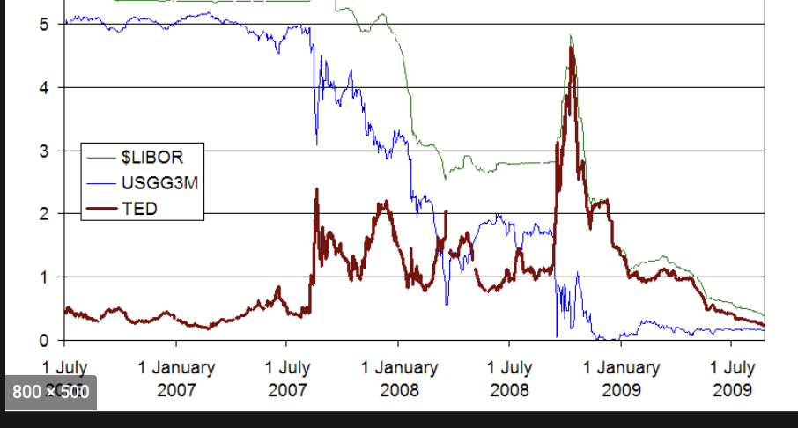

Slide 18
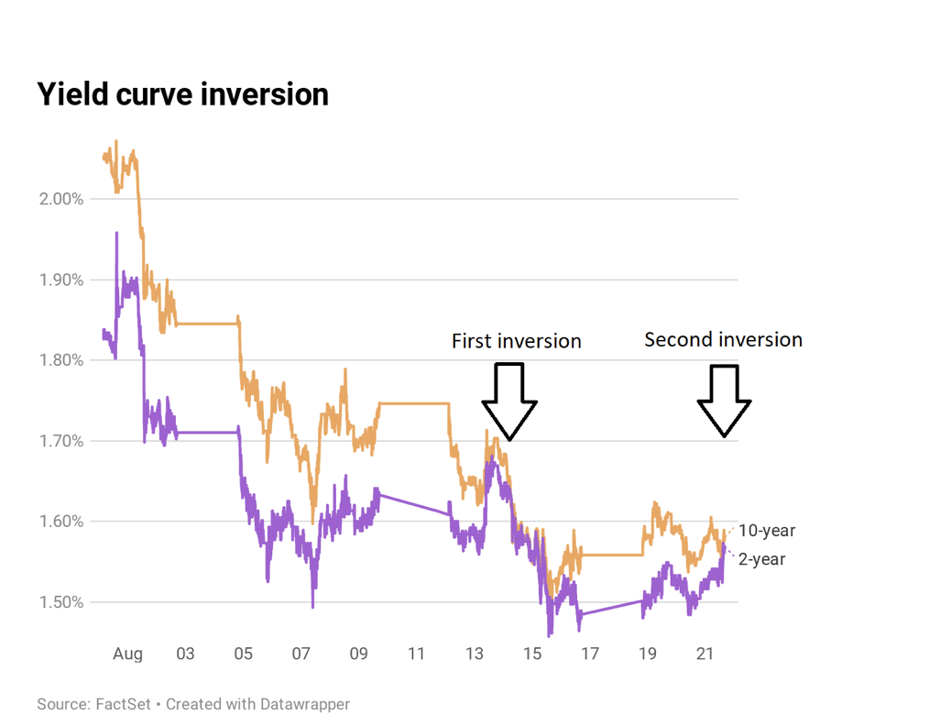
Treasury Yield Curve

Slide 19
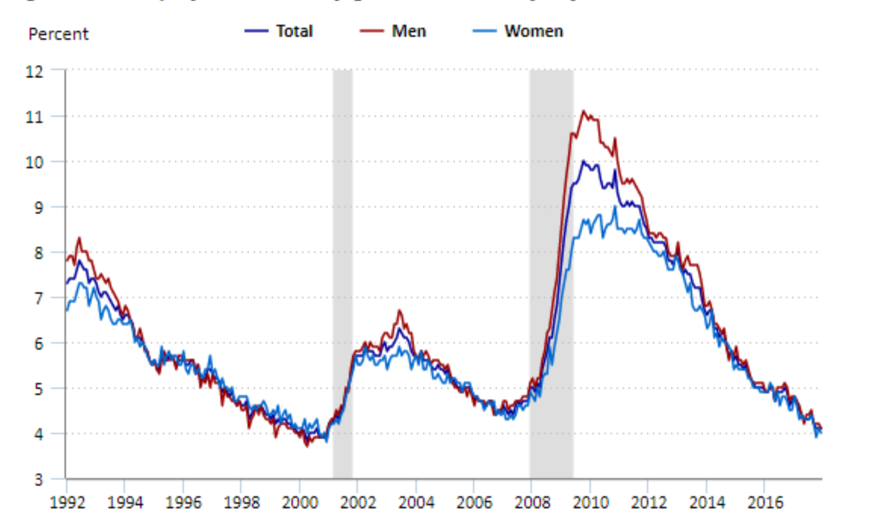
Stock Market Crash Data: Unemployment

Slide 20
Other Trackers
NFIB Small Business Optimism Index
Housing Market Data
NAHB Home Builders Index
P/E Ratio
Debt-to-Equity Ratio
EPS

Slide 21
Finance Modeling Approaches
Probabilistic
Deterministic
Discrete Difference Equations
Continuous Difference Equations
Simulations
Approximations
Asymptotic Analysis
Green’s Function

Slide 22
Indicators of
Asset Bubble

Slide 23
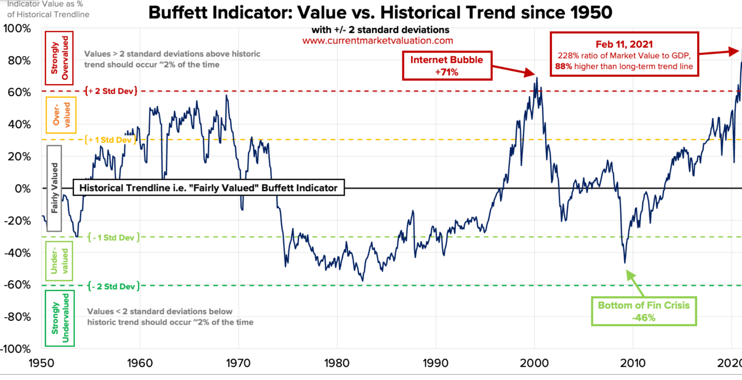
Prolonged Dovish Monetary Policy

Slide 24
High Cyclically Adjusted Price-to-Earnings Ratio (CAPE Ratio)
Some use the CAPE ratio to determine whether the markets as a whole are undervalued, in which case they should go higher, or overvalued, which suggests they're headed for a crash. The CAPE ratio for the S&P 500 Index at the end of January 2021 stood at 33.74.

Slide 25
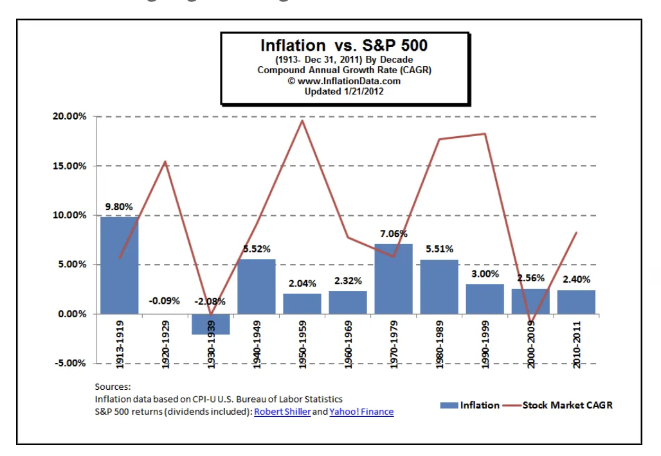
Rising Inflation

Slide 26
Buffet Indicator

Slide 27
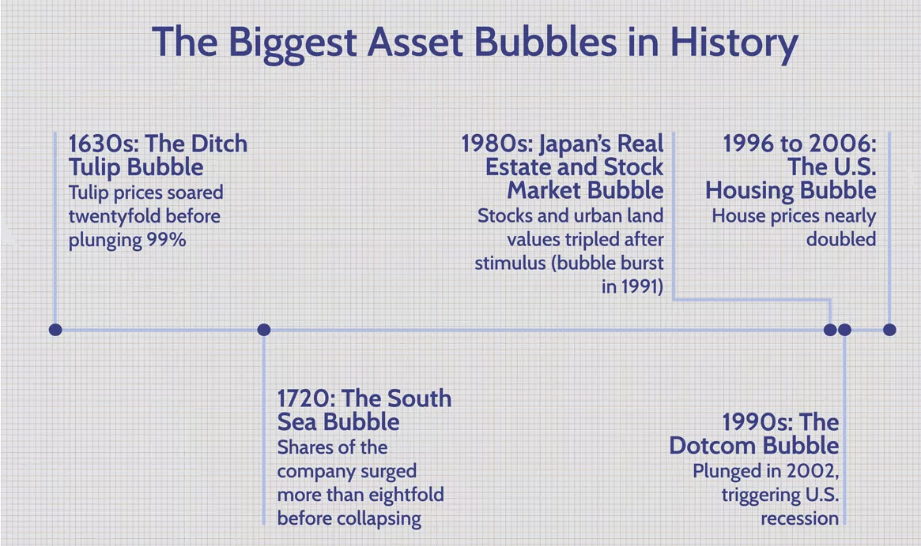
Final Framework

Slide 28
2002 DotCom Bubble
Factors:
Speculation of Crash
Investor Hype and Over-Evaluation
Expert’s Opinion
Taxpayers relief act of 1997

Slide 29
2008 Global Financial Crisis
Factors:
Excessive Risk-Taking in favourable macro-economic environment.
Increased borrowing by banks and investors.
Regulation and Policy Errors.

Slide 30
Statistical
Approach

Slide 31
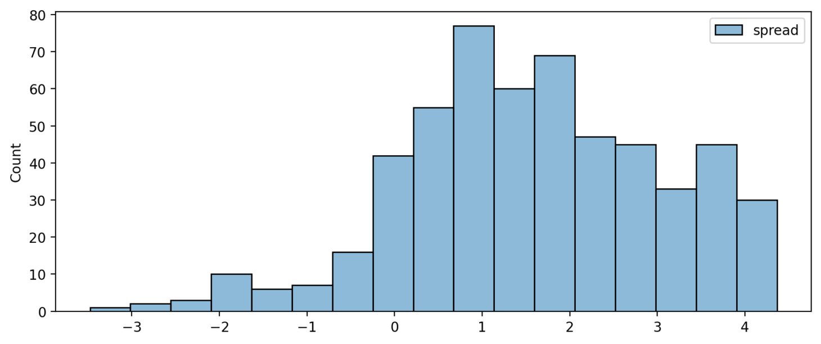
Histogram

Slide 32
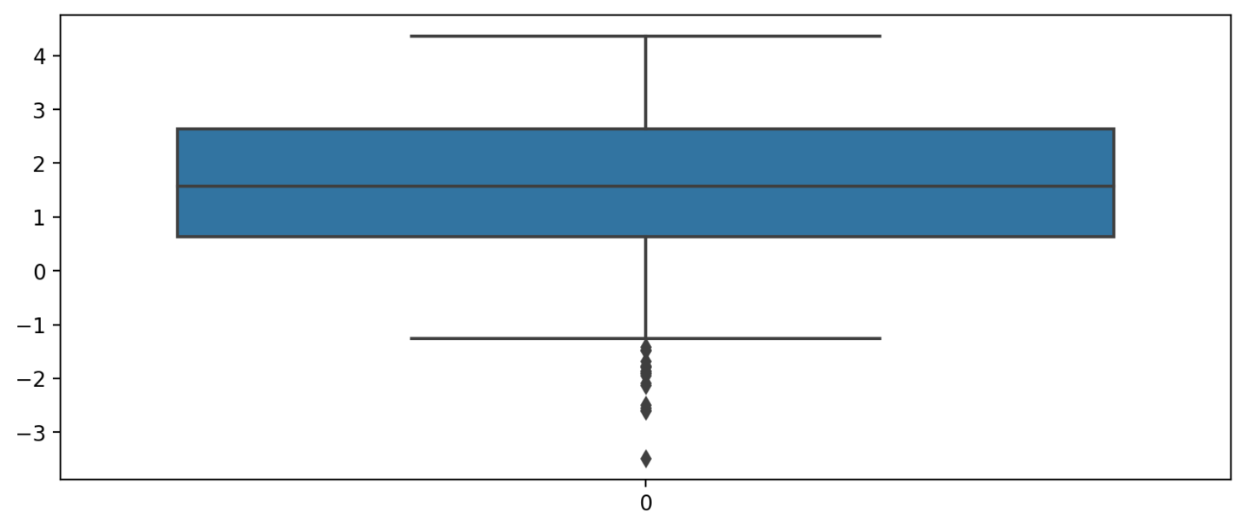
BoxPlot:
Whisker’s Parameters has been added to form the given boxplot.

Slide 33
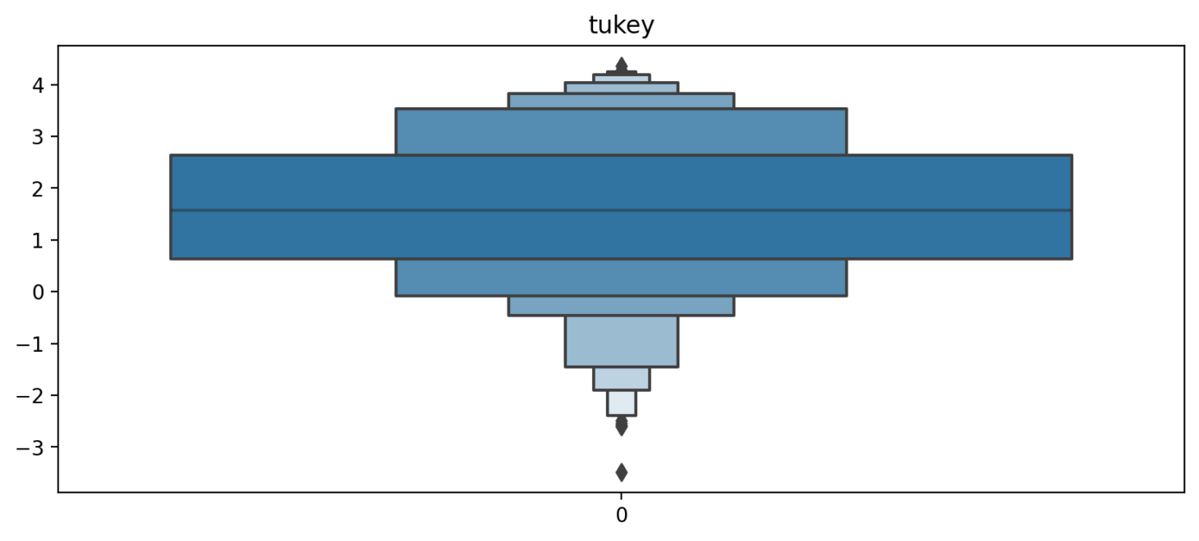
BoxenPlot
K-Depth parameter has been added to form customized boxenplots.

Slide 34
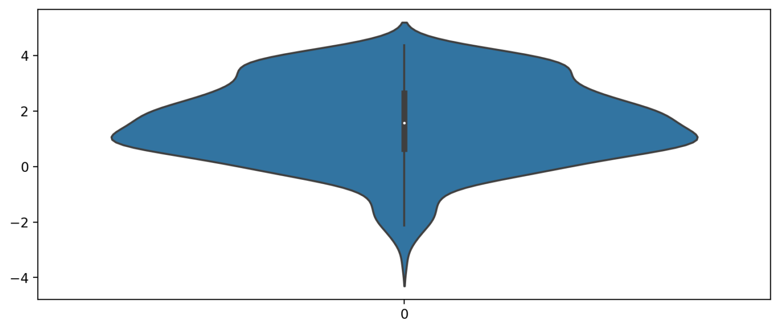
Violin Plot

Slide 35
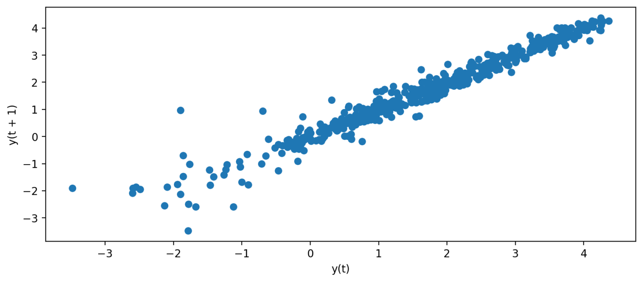
Lag Plot

Slide 36
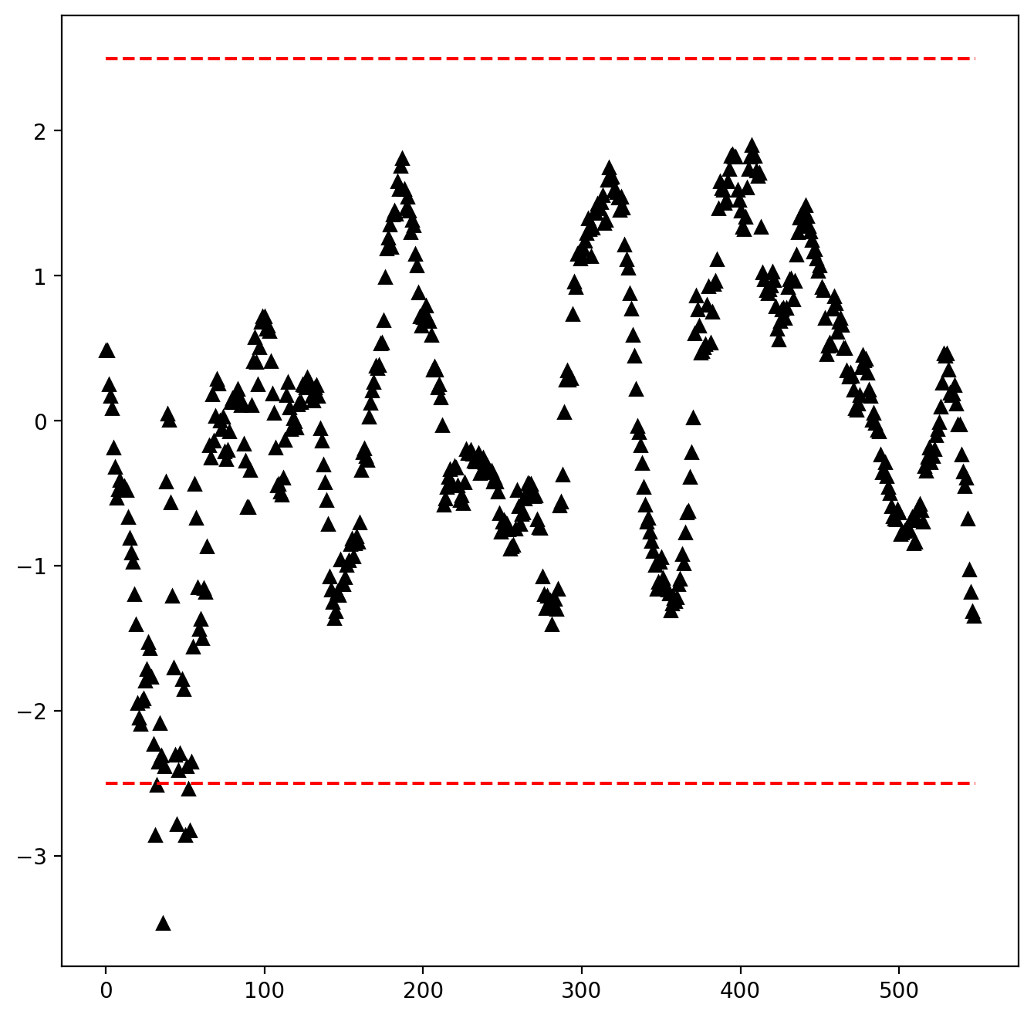
Z-Score Method:

Slide 37
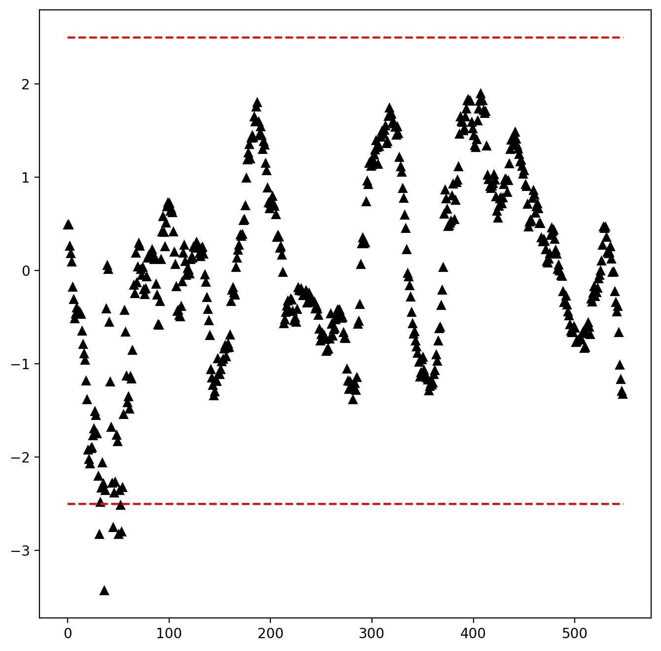
Modified Z-Score Method:

Slide 38
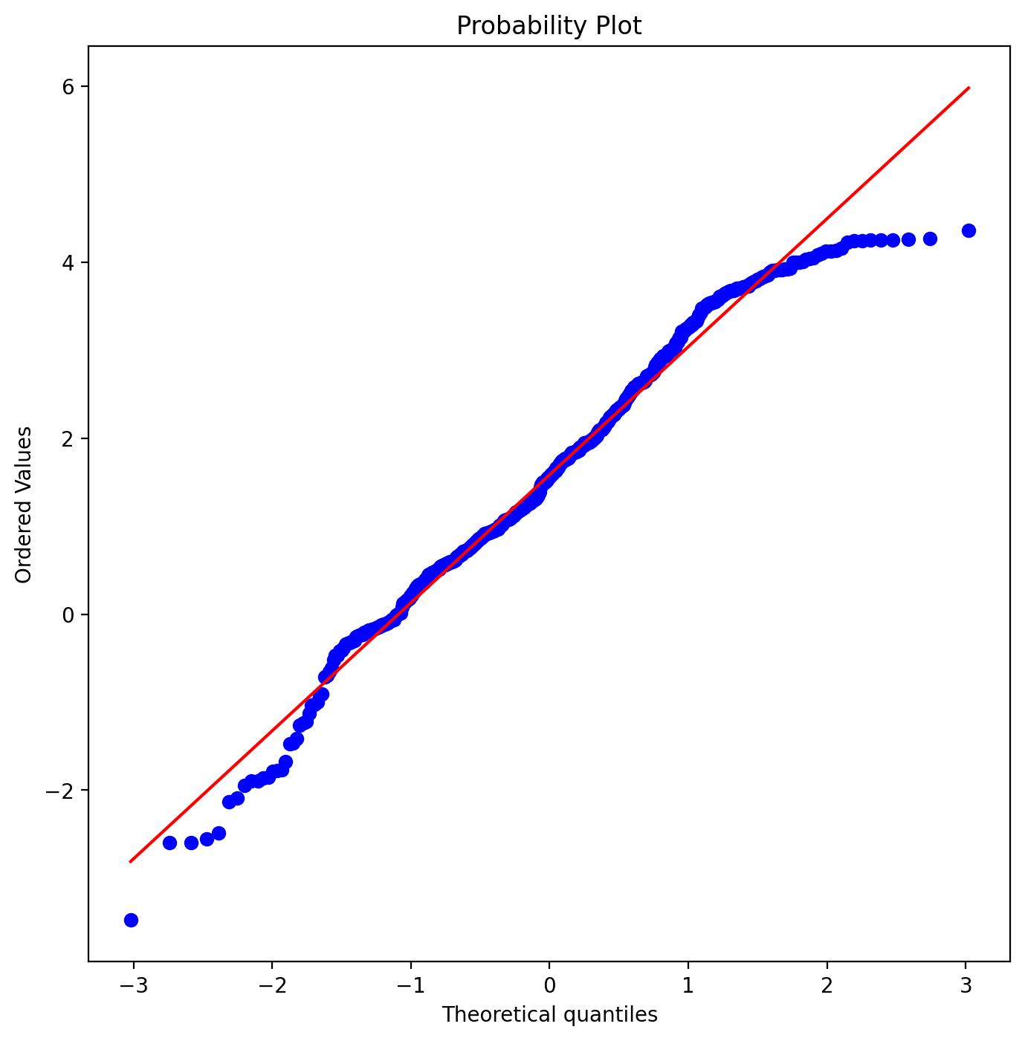
Quantile-Quantile (QQ) Plot

Slide 39
Other Methods:
Tukey Method
Kolmogorov-Smirnov Test

Slide 40
Log Periodic Power Law Singularity
(LPPLS) Model
The LPPLS model provides a flexible framework to detect bubbles and predict regime changes of a financial asset. A bubble is defined as a faster-than-exponential increase in asset price, that reflects positive feedback loop of higher return anticipations competing with negative feedback spirals of crash expectations. It models a bubble price as a power law with a finite-time singularity decorated by oscillations with a frequency increasing with time.

Slide 41
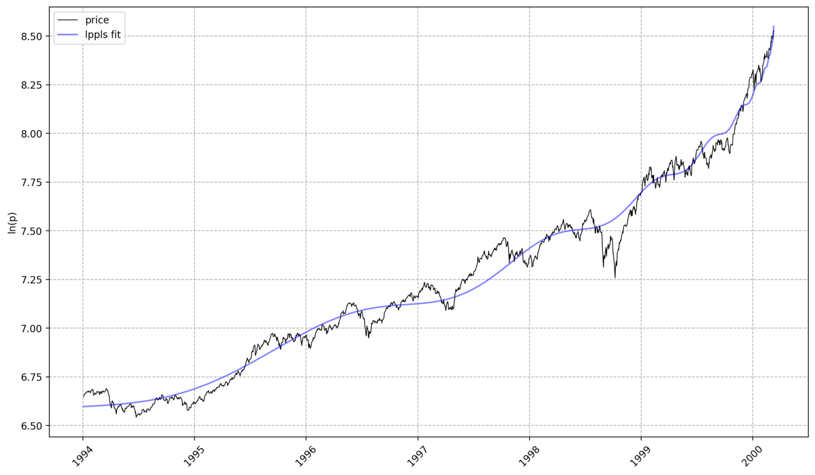

Slide 42
Web-App Interface :
The web-app holds the interface to showcase the figures generated by customized parameters to find the outliers aka bubbles.

Slide 43
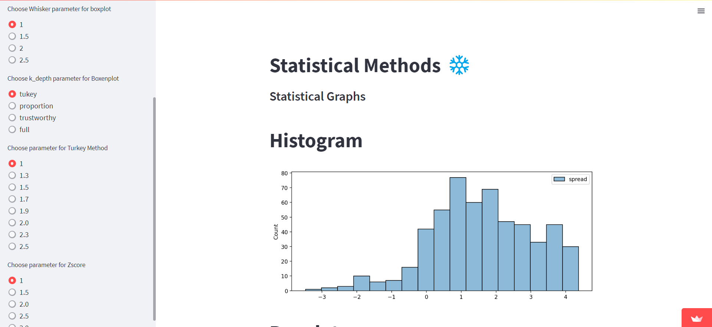
Parameters
Generated Figures

Slide 44
Machine Learning Driven Approach

Slide 45
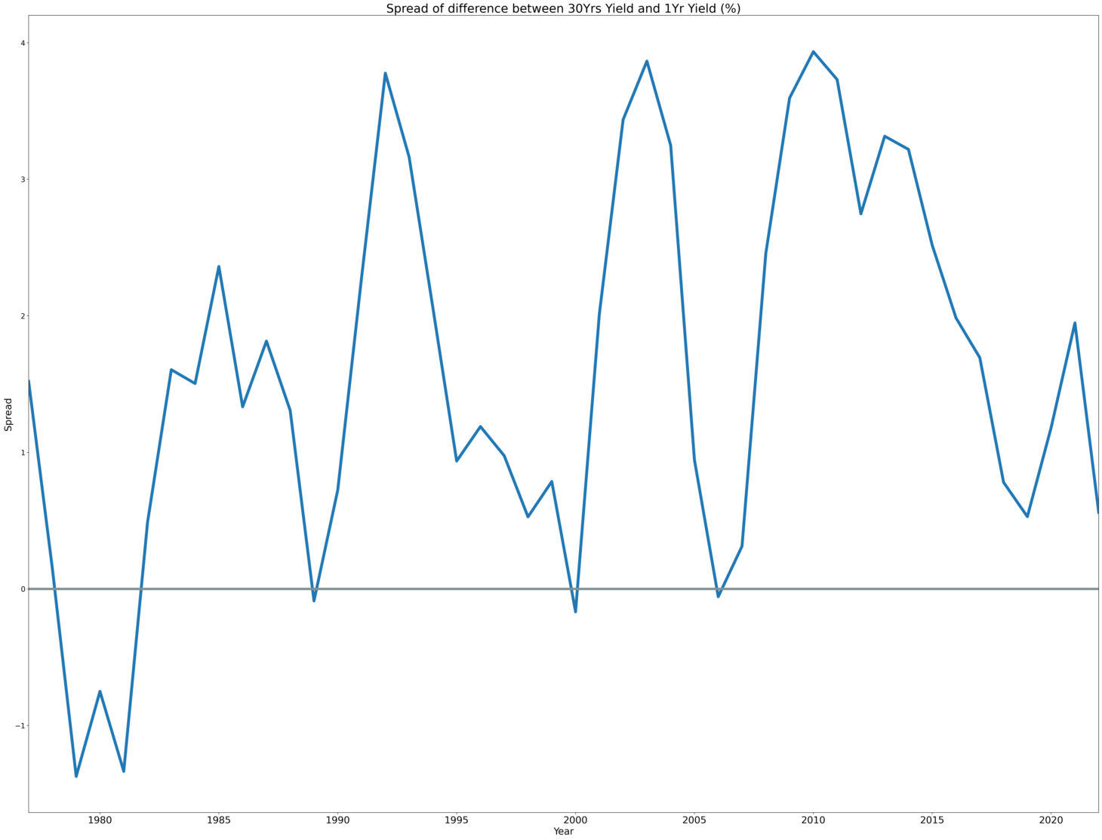
Spread of Difference

Slide 46
1978 - 1981. Wow. The 2 yield curves were on average inverted for 4 years. This is marking the US Recession that started in 1980.
Another touch in 1989. This is also marking the US early 1990 Recession, which was relatively mild, but still existed. (quite accurate!)
The year 2000. This is starting to look like a very good predictor. The recessions in 2000 affected mostly the developed countries, and in US was caused by the Market Bubble.
Well this is actually ridiculous! Another touch in 2006. I don't even need to address that period. US economy and employment had a slowdown, while the debts were rising. It was the climax for the recession in 2008.
And now we're approaching to the present. And as you can see from the second graph, that line is slowly but surely approaching the 0 line, where the difference between the 30 Yr Maturity and the 1 Yr Maturity is becoming negative.

Slide 47
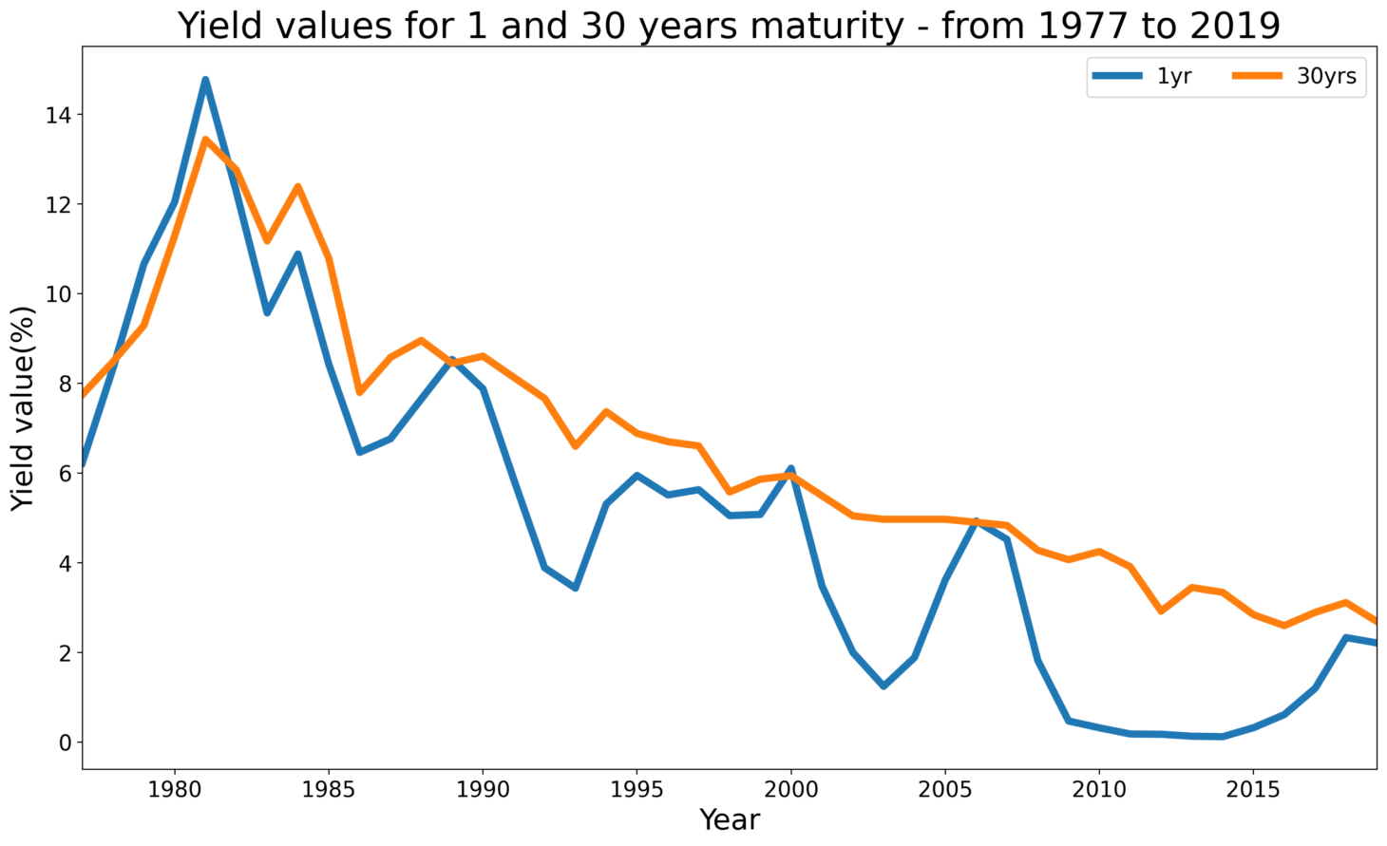
Yield Curves

Slide 48
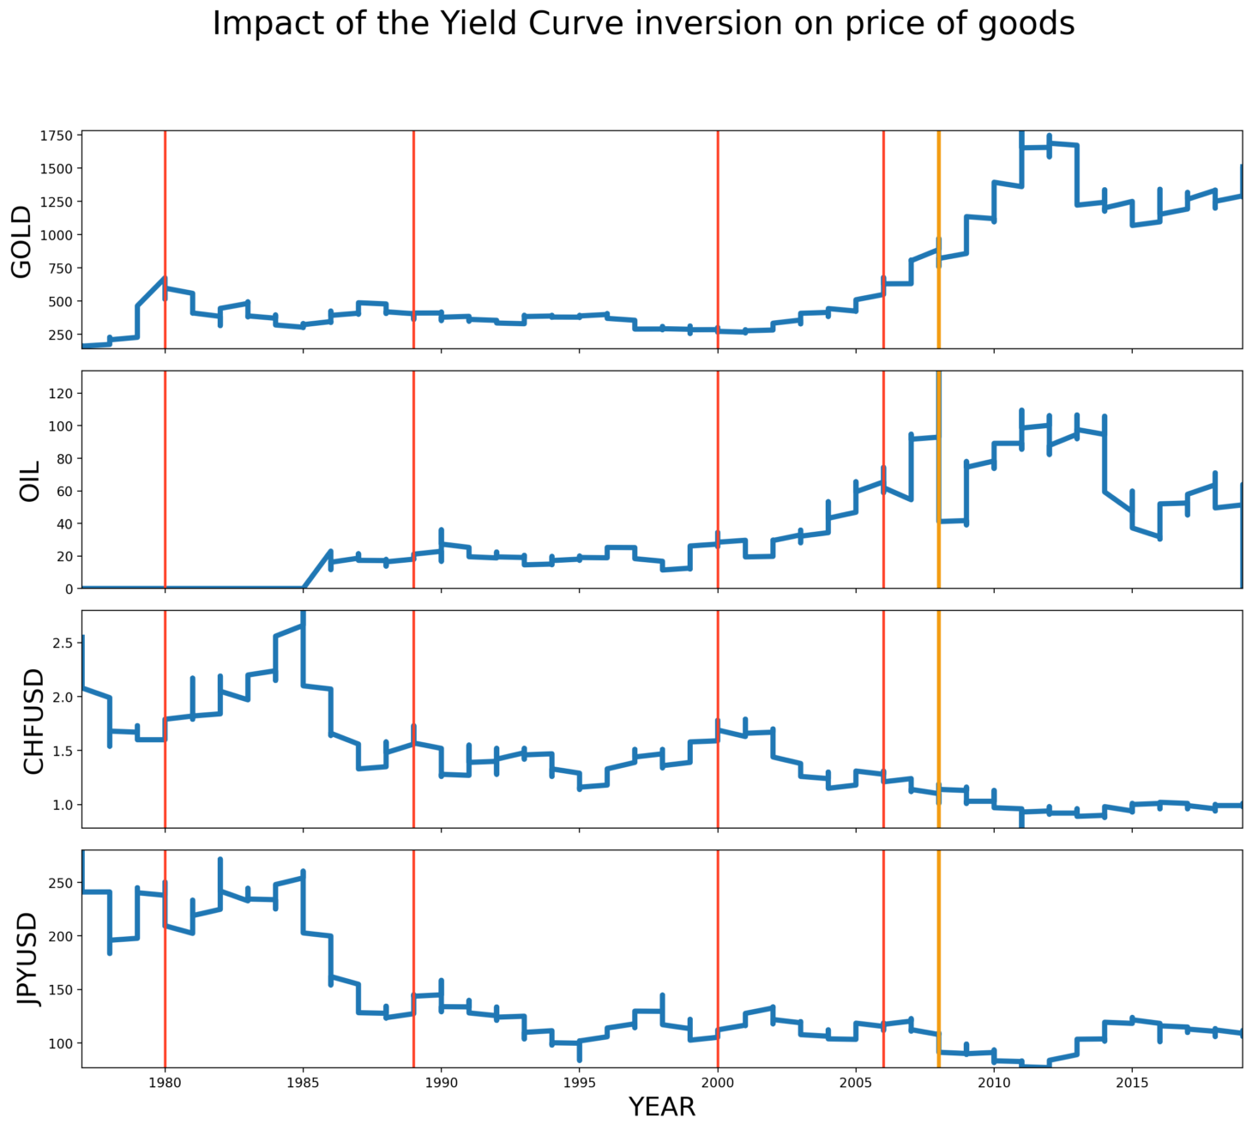

Slide 49
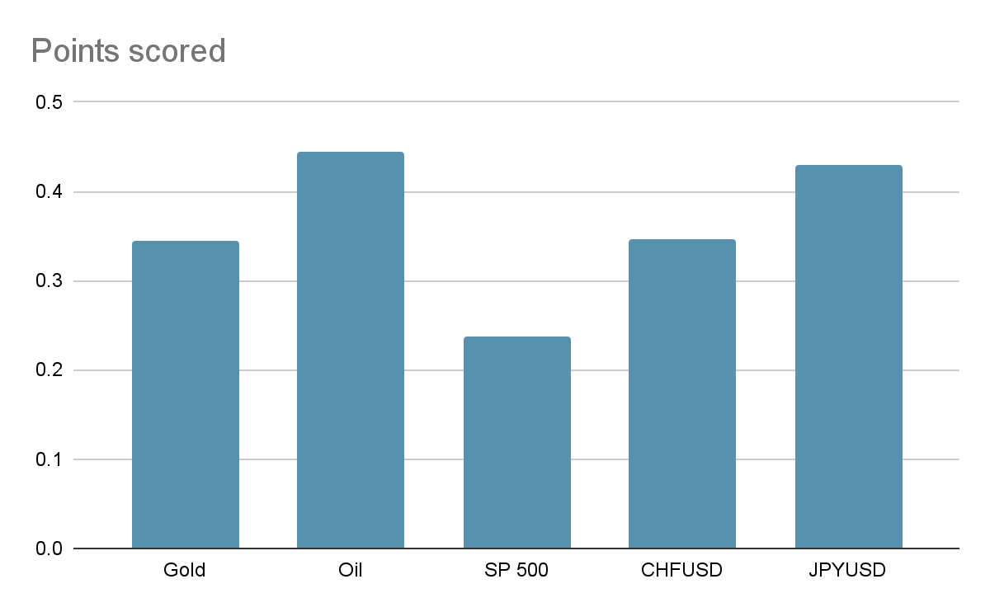
Correlation between factors :

Slide 50
Not quite sure if there is a pattern to be discovered, although there can be seen some tendencies.
To be sure, let's check the Pearson Correlation Coefficient (you can see below the correlations and their level of confidence, which was very good for all of them).
-Gold was positively correlated (0.33). So investors put their money in gold when times are uncertain;
-Crude oil is positively correlated (0.44). Same with oil, investors store their money here when economy isn't at its greatest;
-Swiss Franc is negatively correlated (-0.34). Investors run from the Swiss;
-Japanese Yen is negatively correlated (-0.42). They also run from the Japanese.

Slide 51
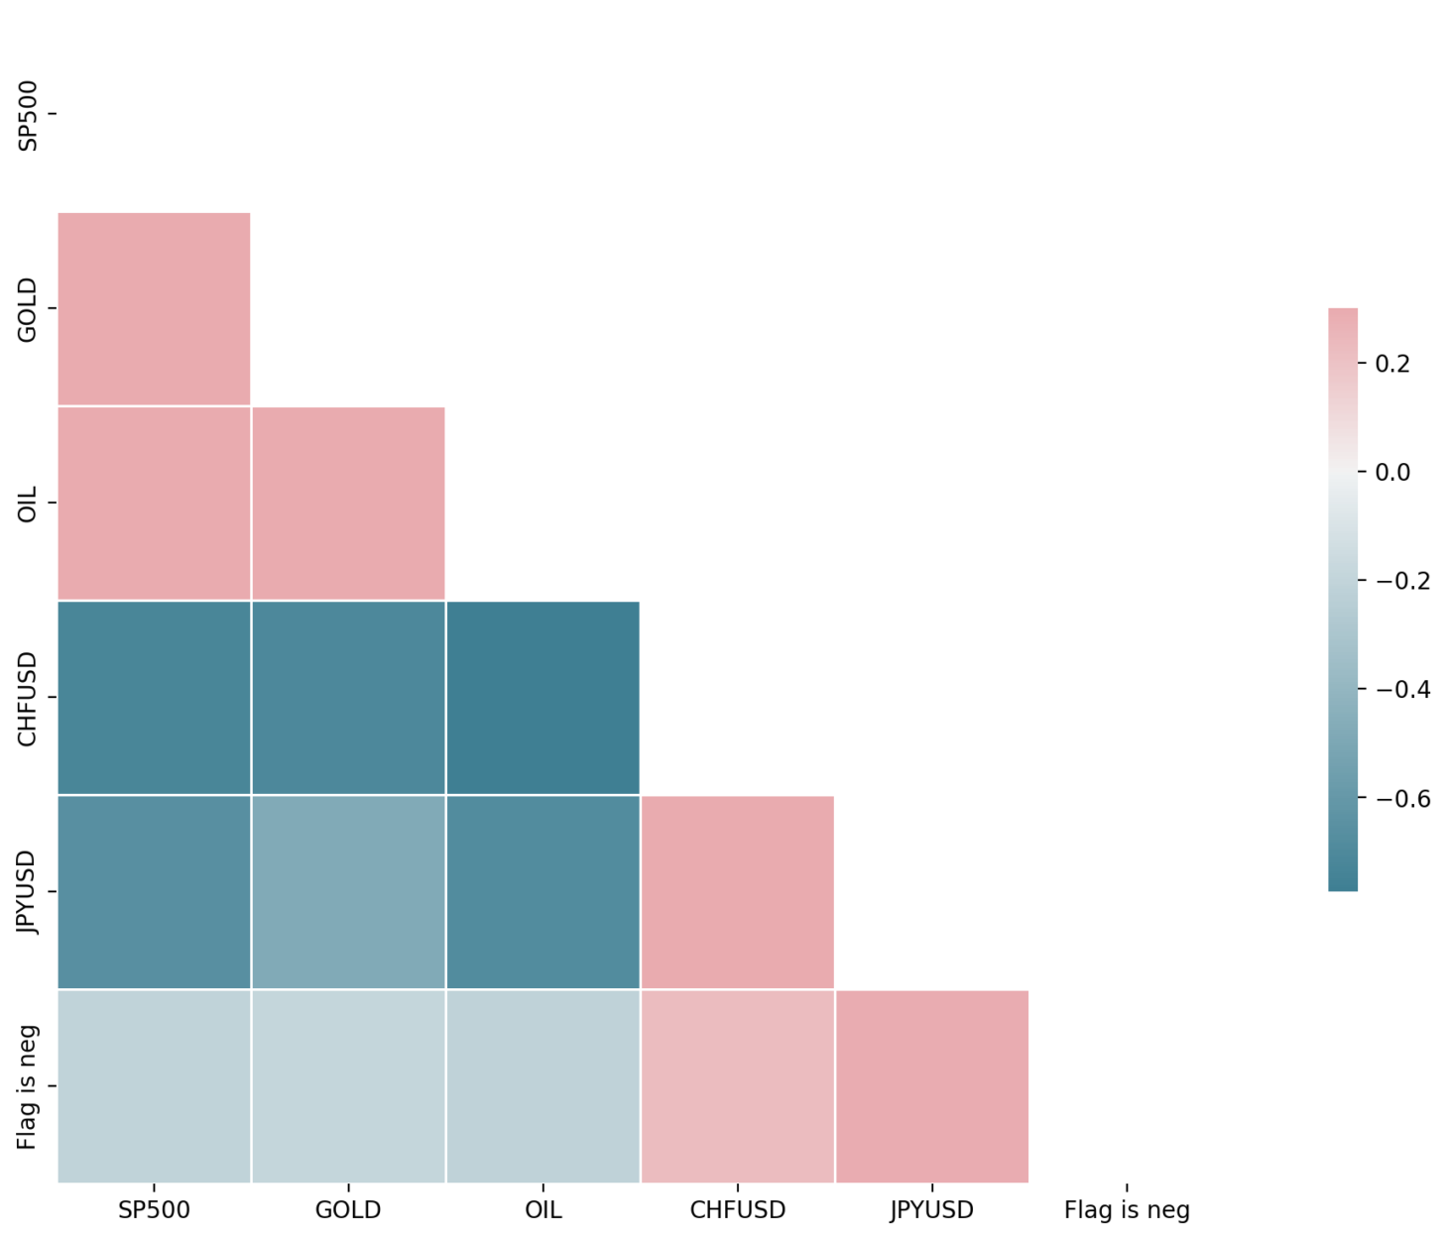
HeatMap

Slide 52
Prediction Models
KNN Outlier Detection
LOF
Cluster-Based Local Outlier Factor (CBLOF)
Isolation Forest
One-Class Support Vector Machine (OCSVM)
COPOD
Median-Absolute Deviation

Slide 53
ML Web-App Interface
The ML web-app has been added with similar customization in parameters.
The results can be checked with a wide variety of parameters.
Some parameters are -
k-value
method
n_neighbors
kernel type

Slide 54
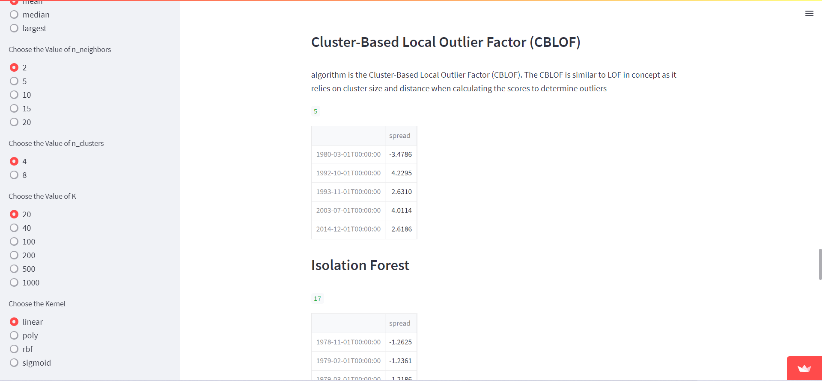

Slide 55
THANK YOU

